Slide 1
UK General Election Prediction
Wenjing Chen
Yiwei Sun
Kunli Duan

Slide 2
Today is
7th June, 2017

Slide 3
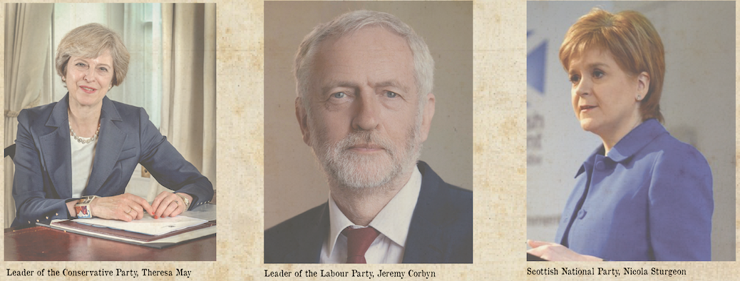
01
Context
0.1
Topic: UK General Election Prediction in 2017
Background introduction: The day before UK general election
Why important: Since April, May and June in 2017,
the news top topic is General Election.
Why interesting: Tomorrow will publish the result.

Slide 4
0 2
Data processing
0.1
1. Using Web Crawler technology to grab the BBC news transcript online Json data. There are more than 4.5 million rows in total.
2. Transforming the Json data to array.
3. Cleaning the stop words and choosing noun words by using Natural Language Toolkit (nltk).
4. News topic words frequency stats and analysis. Finally we got around 100 thousand effective topic words to analyze.

Slide 5
03
Audience
0.1
Audience:
1. Financial community---New president means new economic policy. It will influent the direction of investment.
2. The people who care about the UK politics or new president.

Slide 6
Let’s see the
Magic Data Newspaper

Slide 7
THANKS Q&A

